Slide 1
UNIT-I
Renewable Energy Technologies:
Basic principles of Energy conversion: Heat Energy Conversion Principles – Mechanical Energy Principles – Solar Radiation Conversion: Photovoltaic Conversion – Photo Electro Chemical Conversion – Solar Thermal Conversion – Fuel Cells – Basic Principles of Hydrogen – Oxygen fuel cell – factory effecting the Power output – Maximum Power output Bio Energy Conversion Process – Combustion and composting of Bio- Mass – Production of heat by bio-mass – Bio-logical Conversion into gaseous into liquid bio-fuels.

Slide 2
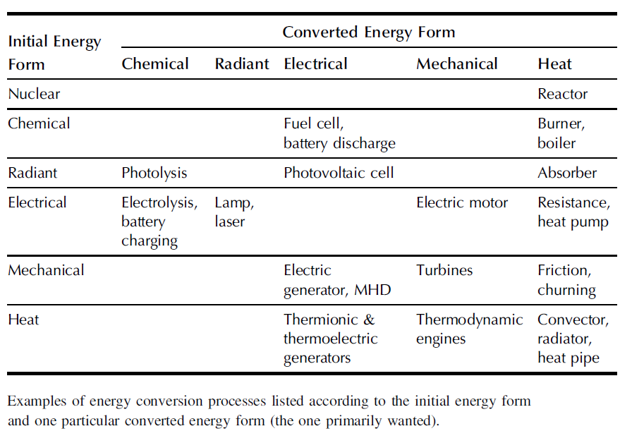

Slide 3
HEAT ENERGY CONVERSION PROCESSES
Direct Thermoelectric Conversion
Engine Conversion of Solar Energy
Heat Pumps
Geothermal and Ocean-thermal Conversion

Slide 4
Direct Thermoelectric Conversion
Thermoelectric Generators
Thermionic Generators

Slide 5
1. Introduction
Thermoelectricity refers to a class of phenomena in which a temperature difference creates an electric potential
converts the heat energy into electrical energy based on the principles of Seebeck effect
The pioneer in thermoelectric was a German scientist Thomas Johann Seebeck (1770-1831)
or an electric potential creates a temperature
difference.
Thermoelectric power generator is a device that
Later,
In 1834, French scientist,
Peltier and in 1851,
Thomson (later Lord Kelvin) described the thermal effects on conductors

Slide 6
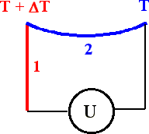
2. Seebeck, Peltier and Thomson effect
Seebeck effect
When the junctions of two different metals are maintained at different temperature, the emf is produced in the circuit. This is known as Seebeck effect.
The conductor 1 is maintained at T+∆T temperature
The conductor 2 is maintained at
temperature ‘T’.
Since the junctions are maintained at different temperature, the emf ‘U’ flows across the circuit.

Slide 7
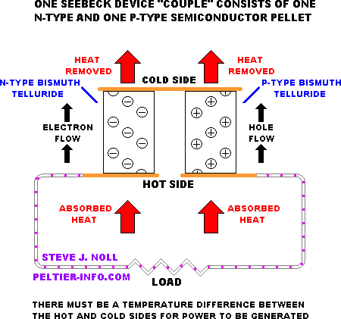

Slide 8
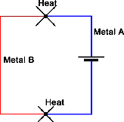
Peltier effect
Whenever current conductors, depending
passes through
the circuit of two dissimilar
on the current direction, either heat is
absorbed or released at the junction of the two conductors. This is known as Peltier effect.
absorbed
released

Slide 9
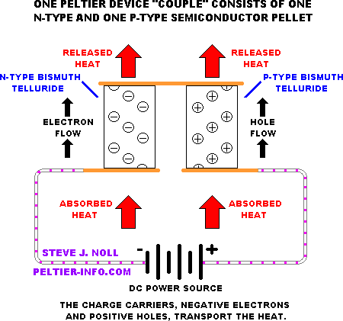

Slide 10
Thomson effect
Heat is absorbed or produced when current flows in material with a certain temperature gradient. The heat is proportional to both the electric current and the temperature gradient. This is known as Thomson effect.
3. Thermoelectric effect
The thermoelectric effect, is the direct conversion of heat differentials to electric voltage and vice versa

Slide 11
4. Thermoelectric materials
The good thermoelectric materials should possess
Large Seebeck coefficients
High electrical conductivity
Low thermal conductivity
The example for thermoelectric materials
BismuthTelluride (Bi₂Te₃),
Lead Telluride (PbTe),
SiliconGermanium (SiGe),
Bismuth-Antimony (Bi-Sb)

Slide 12

5. Principle, construction and working of Thermoelectric power generator
Thermoelectric power generator based on the principle of Seebeck effect that when the junctions of two different metals are maintained at different temperature, the emf is produced in the circuit
Heat input
Hot junction
P-type
N-type
Cold junction
Heat ejection
Power output

Slide 13
In order to select materials and design a thermoelectric generator, one needs to start with a general understanding of the thermoelectric effects.
In a thermoelectric material there are free carriers which carry both charge and heat.
Perhaps the simplest example is a gas of charged particles.
If a gas is placed in a box within a temperature gradient, where one side is cold and the other is hot, the gas molecules at the hot end will move faster than those at the cold end.
The faster hot molecules will diffuse further than the cold molecules and so there will be a net build up of molecules (higher density) at the cold end.
The density gradient will cause the molecules to diffuse back to the hot end.

Slide 14
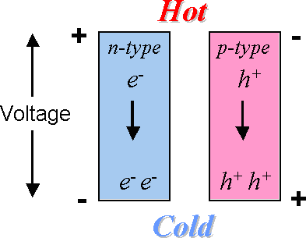
In the steady state, the effect of the density gradient will exactly counteract the effect of the temperature gradient so there is no net
flow of molecules.
If the molecules are charged, the buildup of charge at the cold end will also produce a repulsive electrostatic force (and therefore electric potential) to push the charges back to the hot end.
Diagram shows
The charge buildup at cold side

Slide 15
The electric potential produced by a temperature
difference is known as the Seebeck effect
and the
proportionality constant is called the coefficient.
Seebeck
If the free charges are positive (the material is p-type),
positive charge have a
will build up on the cold which will
positive potential.
Similarly, negative
free charges (n-type material) will
produce a negative potential at the cold end.

Slide 16
Construction
Thermoelectric power generation (TEG) devices typically use special semiconductor materials, which are optimized for the Seebeck effect.
The simplest thermoelectric power generator consists of a thermocouple, comprising a p-type and n-type material connected electrically in series and thermally in parallel.
Heat is applied into one side of the couple and rejected from the opposite side.
An electrical current is produced, proportional to the temperature
gradient between the hot and cold junctions.

Slide 17
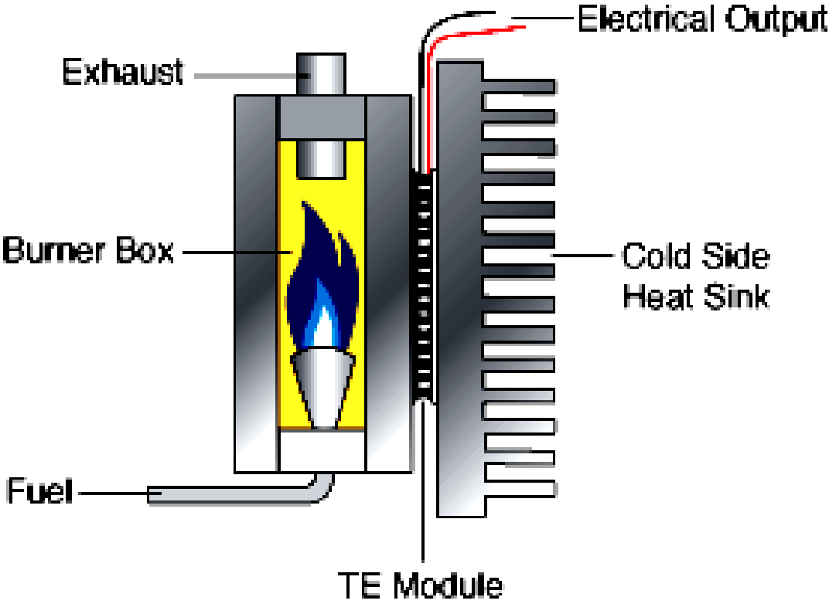
Therefore, for any TEPG, there are four basic component required such as
Heat source (fuel)
P and N type semiconductor stack (TE module)
Heat sink (cold side)
Electrical load (output voltage)

Slide 18
The figure shows the construction of thermoelectric
power generator.
There is a burner in which the propane fuel is used as heating source in one side.
The exhaust is used to transmit a burnt fuel.
On the other side, a cold junction is kept.
The thermoelectric module (TE) (consist of number of
P- type and N-type semiconductor pellets connected in
series or between
parallel depending on the served load)) is kept in the hot and cold junction.
The electrical out (load) is taken from the TE module.

Slide 19


Working
When the two sides of semiconductor are maintained with different temperature, the emf is flows across the output circuit
N-type
Cold side
Hot side
Heat flow
V
Electron flow

Slide 20
As the heat moves from hot side to cold side, the carrier moves in the semiconductor materials and the potential deference is created.
charge hence
The electrons are the charge carriers in the case of N- type semiconductor and Hole are in P-type semiconductors.
In a stack, number of P-type and N-type
semiconductors is connected.
A single PN connection can produce a Seebeck of 40 mV.
voltage
The heat source such as natural gas or propane are
used for remote power generation

Slide 21
Major Types available
Fossil fuel generators
Solar Source generators
Nuclear Fuel generators

Slide 22
Advantages
Easy maintenance: They works electrically without any moving parts so they are virtually maintenance free.
•
Environment friendly: Thermoelectric
generators
produce no pollution. Therefore they are eco friendly
generators.
Compact and less weight: The overall thermoelectric
cooling system is much smaller and lighter than a comparable mechanical system.
High Reliability: Thermoelectric modules exhibit very
high reliability due to their solid-state construction

Slide 23
No noise: They can be used in any orientation and in zero gravity environments. Thus they are popular in many aerospace applications.
Convenient Power Supply: They operate directly from a DC power source.

Slide 24
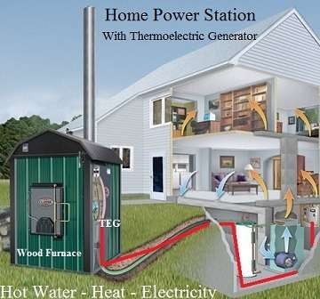
Applications

Slide 25
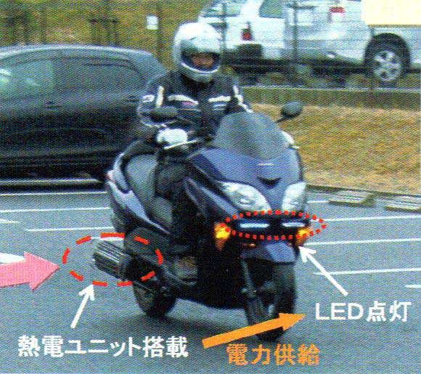
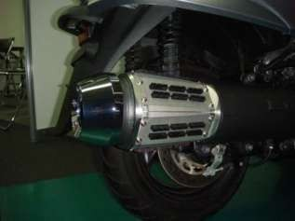
Load : LED lighting
TEG System

Slide 26
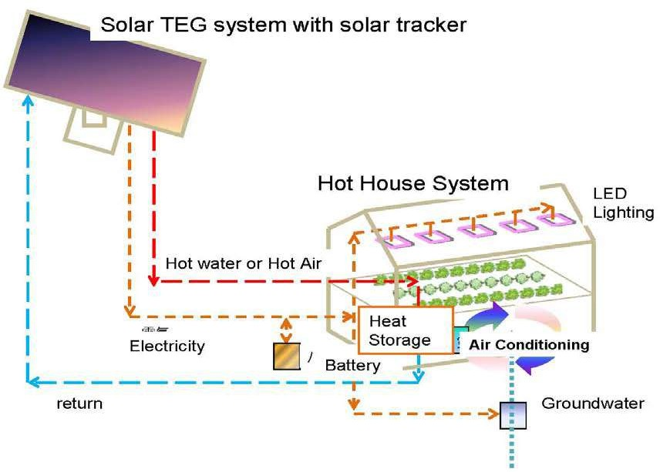

Slide 27
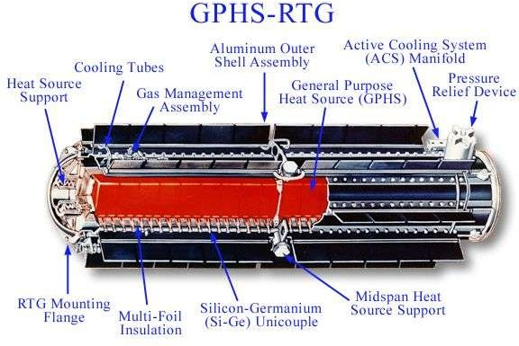

Slide 28
THERMIONIC

Slide 29
Introduction
Thermionic Power Convertor is a static device that converts heat into electricity by boiling electrons from a hot emitter surface(approx 1800 K) across a small inter electrode gap(<
0.5 mm) to a cooler collector surface(approx 1000 K)
A Thermionic Generator consists of one or more of these convertors coupled to give desired power output
Thermionic generators can be operated from any primary heat source.
For low power level(3 kW or less) solar energy can be used
For high power level (50 kW or more) nuclear heat source can
be used

Slide 30
History
In 1883 Edision discovered release of electrons from a hot body
In 1904 Fleming invented thermionic diode rectifier
In 1915 Schlicter proposed thermionic conversion
After 1950 serious research on this began

Slide 31
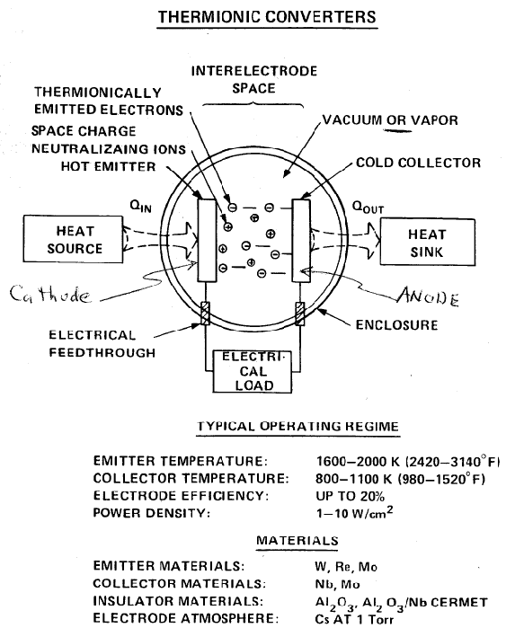
Common components

Slide 32
Important aspects considered
The cathode must emit an abundant supply of electron
Evaporation of atoms from cathode should be negligible
Electronic space charge build-up in the inter- electrode spacing must be eliminated

Slide 33
Classification
Classification according to methods of neutralization space charge
Vacuum close-spaced
Cesium Gas Filled

Slide 34
Vacuum close-spaced convertor
Has been under extensive research since 1957
Physical spacing of .0005 inch or less is maintained between anode and cathode
Will have engineering difficulty
Lifetime is 40 hours

Slide 35
Cesium Gas Filled
Cesium gas is filled between anode and cathode
Working efficiency is higher than former one
Lifetime is nearly 600 hours
Main problem is efficient sealing and corrosive nature of cesium

Slide 36
Advantages
Rotating equipment is not employed
Liquid-Vapour phase problems do not exist
Separators for fluids are not required
Frictional losses due to bearings not present

Slide 37
Disadvantage
Individual convertors are low voltage, high current devices
A large number of convertors must be sequentially arranged to obtain useful voltage
Power losses in convertors can seriously cut useful power output

Slide 38
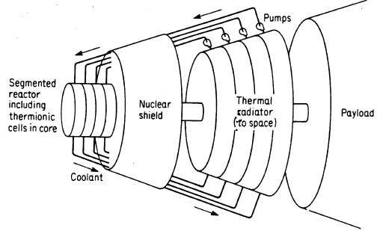
Application

Slide 39
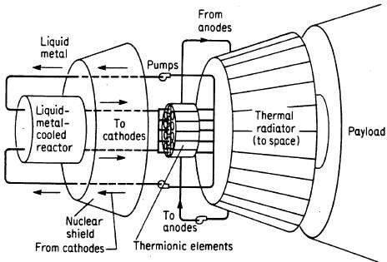

Slide 40
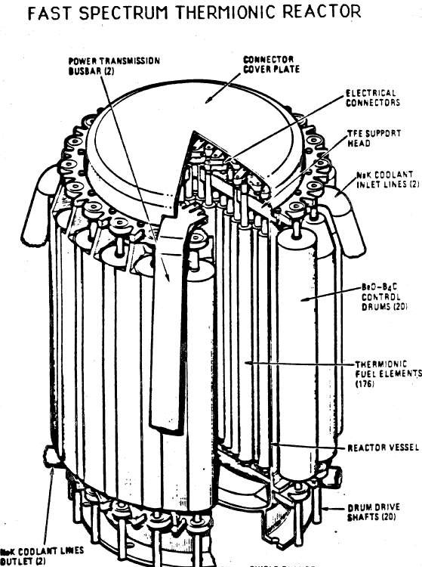

Slide 41
COMBINATION OF THERMIONIC AND THERMOELECTRIC

Slide 42
Comparison
Both thermionic and thermoelectric generators employ the electron gas as the working fluid
A thermionic generator based on the ballistic current flow which is highly efficient, and its theoretical efficiency is close to the Carnot efficiency
A thermoelectric generator, however, has poor efficiency due to the diffusive current flow
A thermionic generator usually requires a high- temperature heat source (e.g. 1500 K) to generate a practically useful current
A thermoelectric generator, however, can produce electrical power from low-quality heat energy sources

Slide 43
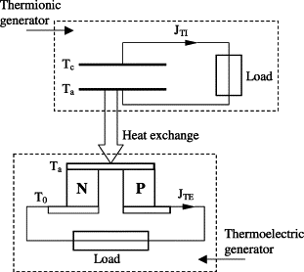
Combination

Slide 44
The Stirling Engine

Slide 45
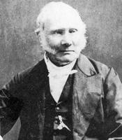
History
Reverend Dr. Robert Stirling (1790-1878)
Patented Stirling Engine in 1816
Invented air engine because steam engines would explode and harm workers.

Slide 46
How It Works
Works by heating and cooling a gas inside a sealed chamber.
Heating
Expansion
Cooling
Contraction

Slide 47
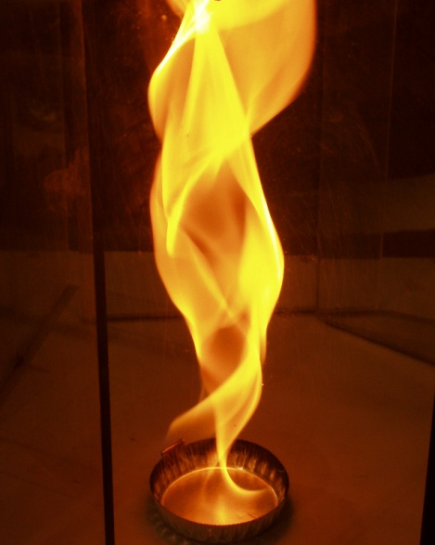
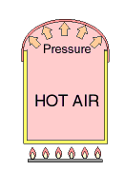
The Stirling Cycle
Heating
Expansion

Slide 48
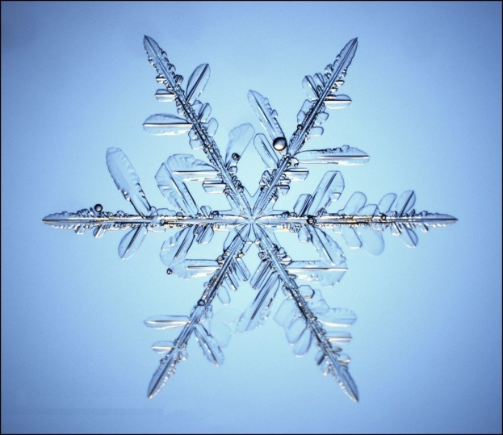
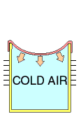
The Stirling Cycle
Cooling
Contraction

Slide 49
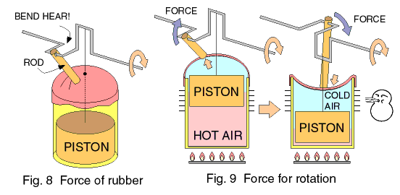
The Stirling Cycle Complete

Slide 50
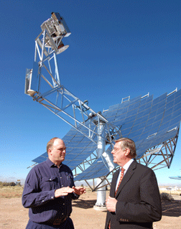
Current Applications
Solar to electric generation
Current record achieves 29.4% peak efficiency

Slide 51
Solar Dish Engines
Main advantage, adaptable to ANY heat source (fuel, gas, wood, coal, nuclear) anything that produces heat.

